Slide 1
Newton’s Third Law
Section 14.3

Slide 2
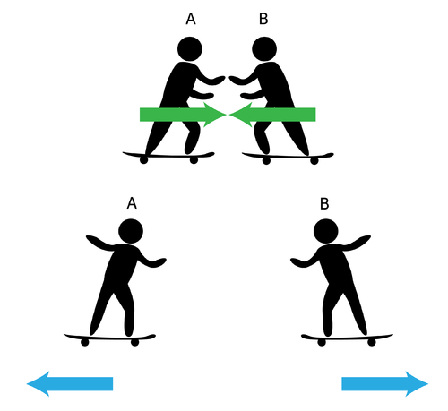
Introduction
Skateboarders push against each other and they move apart.
The harder they push the farther apart they move.
This is Newton’s Third Law.

Slide 3
The Third Law of Motion
Newton’s third law of motion – states that every action has an equal and opposite reaction.
Forces always act in pairs
when one object exerts a force on a second object, the second one exerts a force on the first that is equal in strength and opposite in direction

Slide 4
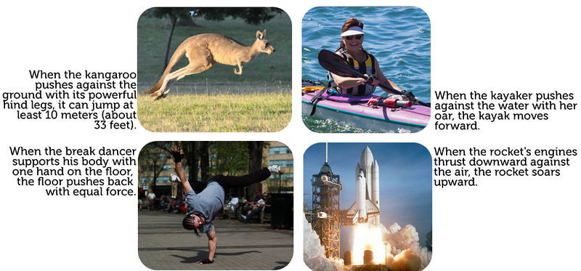
Action and Reaction

Slide 5
Action and Reaction
when you jump on a trampoline, you exert a downward force on the trampoline
the trampoline exerts an equal force upward, sending you high into the air

Slide 6
Action and Reaction forces don’t cancel
You might think that actions and reactions would cancel each other out like balanced forces.
But action and reaction forces act on different objects
Even though the forces are equal, they are not balanced because they act on different objects
https://www.youtube.com/watch?v=MUgFT1hRTE4

Slide 7
Momentum
Momentum – a property of a moving object that makes the object hard to stop.
It equals the object’s mass times its velocity.
Momentum = Mass x Velocity
https://www.youtube.com/watch?v=e1lzB36aHD4

Slide 8
Terminal Velocity
terminal velocity
forces on a falling object are balanced (gravity and air resistance) and the object falls with constant speed
As an object falls, the downward force of gravity causes the object to accelerate.
As an object falls faster, the upward force of air resistance increases.
This causes the net force on a sky diver to decrease as the sky diver falls.

Slide 9
Terminal Velocity
The terminal velocity is the highest speed a falling object will reach.
The terminal velocity depends on the size, shape, and mass of a falling object.

Slide 10
Centripetal Force
centripetal acceleration
acceleration toward the center of a curved or circular path
when a ball has centripetal acceleration, the direction of the net force on the ball also must be toward the center of the curved path (Newton’s 2nd Law)
centripetal force
the net force exerted toward the center of a curved path

Slide 11
Centripetal Force and Traction
a car rounding a curve on a highway has centripetal force acting on the car to keep it moving in a curved path
the centripetal force is the frictional force, or the traction, between the tires and the road surface

Slide 12
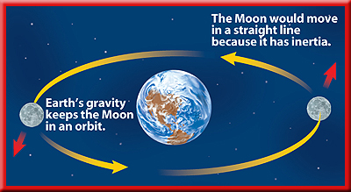
Gravity Can be a Centripetal Force
Earth’s gravity exerts a centripetal force on the Moon that keeps it moving in a nearly circular orbit

