Slide 1
Measuring Waves
Section 19.2

Slide 2
Introduction
Tsunamis are one example of waves.
These waves are extremely large and can cause incredible destruction.
Most tsunamis are described or measured by their height.
Height is just one way we measure waves.
This section is going to cover the different ways we measure waves.

Slide 3
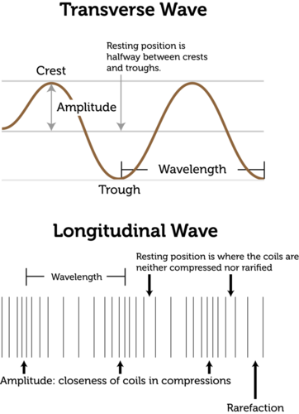
Wave Amplitude and Wavelength
Amplitude – the height of a wave.
Wavelength – distance between two points on adjacent waves.

Slide 4
Wave Amplitude
The maximum distance the particles of a medium move from their resting position when a wave passes through.
Resting position – where the particles would be in the absence of a wave.
Transverse wave – amplitude is height of the crest above the resting position.
Longitudinal wave – amplitude is how compressed particles are when wave passes through.

Slide 5
Wave Amplitude
A waves amplitude depends on the energy of the disturbance that causes the wave.
Example: small pebble dropped in pond versus huge boulder dropped in pond

Slide 6
Wavelength
Wavelength can be measured as the distance between two crests of a transverse wave or two compressions of a longitudinal wave.
Usually measured in meters.
Related to the energy of a wave.
Short-wavelength have more energy than long-wavelength waves of the same amplitude.

Slide 7
Period
Any motion that repeats at regular time intervals is called periodic motion.
The time required for something to complete one full cycle, a complete motion that returns to its starting point, is called the period.
Example: For an ocean wave, the period is the time between two crests that come after one another.

Slide 8
Wave Frequency
Any object that goes through periodic motion has a frequency.
Frequency is the number of complete cycles in a given amount of time.
Frequency is measured in HERTZ (Hz).
A wave’s frequency equals the frequency of the vibrating source that produces the wave.

Slide 9
Wave Speed
Wave speed – how far the wave travels in a given amount of time.
Can be measured in meters traveled per second.
Wave speed is not the same as wave frequency.

Slide 10
Fundamental Wave Equation
You can calculate the speed/velocity of the wave by multiplying a waves wavelength by its frequency.
Note: As you increase the frequency of a wave, you are decreasing the wavelength.
v=f λ
v= velocity (m/s)
f= frequency (Hz)
λ= wavelength (m)

Slide 11
Example
One end of a rope is vibrated to produce a wave with a wavelength of .25 meters. The frequency of the wave is 3.0 Hertz. What is the speed of the wave?

Slide 12
Forms of Equation
Other forms of the equation can be formed
Frequency = Speed Wavelength = Speed Wavelength Frequency

Slide 13
Video

