Slide 1
Friction
Section 13.2

Slide 2
What is Friction?
Friction - force that opposes motion between two surfaces that are touching each other
Friction can work for us or against us.
Examples: Sand on sidewalks to prevent slipping or friction on engine parts that cause them to wear out.

Slide 3
Friction

Slide 4
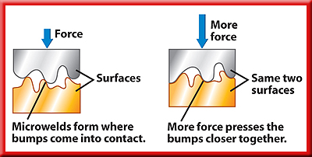
Why Friction Occurs
Friction occurs because no surface is perfectly smooth.
Microwelds - areas where surface bumps stick together and are the source of friction

Slide 5
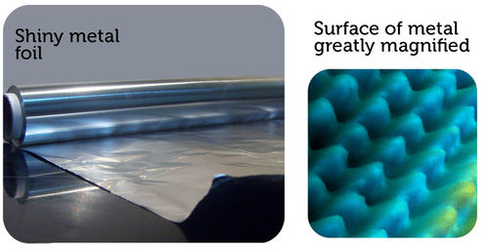
Why Friction Occurs
Metal surfaces look smooth but under a microscope you can see the bumpy appearance.

Slide 6
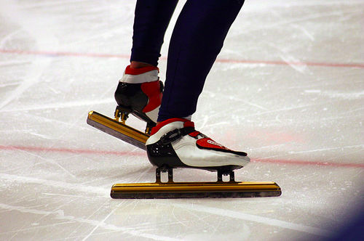
Factors That Affect Friction
Rougher surfaces have more friction.
Heavier objects have more friction.

Slide 7
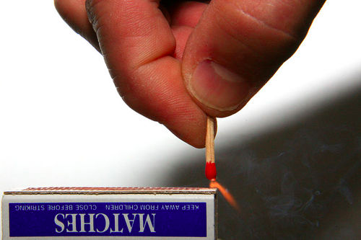
Friction Produces Heat
Friction causes the molecules on rubbing surfaces to move faster, so they have more heat energy.
Examples: rubbing hands together, striking a match, car overheating

Slide 8
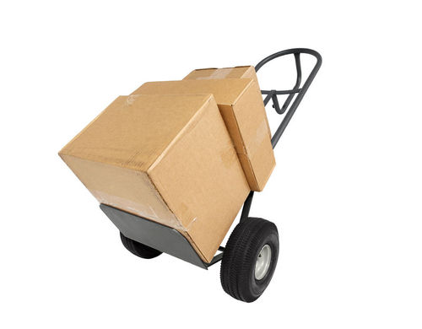
Types of Friction
There are different ways to move heavy boxes.
Pick it up and carry it
Slide it across the floor
Put it on a dolly
This shows 3 of the 4 types of friction
Static friction
Sliding friction
Rolling friction
Fluid friction

Slide 9
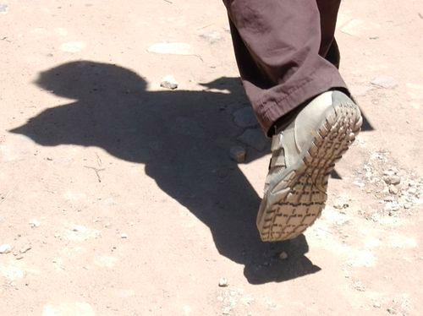
Static Friction
Static Friction – friction between two surfaces that are not moving past each other
Example: walking on a sidewalk, static friction between your shoes and the concrete

Slide 10
Sliding Friction
Sliding friction - force that opposes the motion of two surfaces sliding past each other.
Sliding friction is weaker than static friction.
Examples: sliding furniture across floor, writing with a pencil, brakes on bicycle

Slide 11
Rolling Friction
Rolling friction - friction between a rolling object and the surface it rolls on.
Rolling friction is much weaker than sliding friction or static friction.
This is why using something with wheels makes it easier to move things.

Slide 12
Fluid Friction
Fluid friction - friction that acts on objects that are moving through a fluid.
Fluid – a substance that can flow and take the shape of its container.
This includes liquids and gases.
Air Resistance – fluid pressure with the air.
The faster or larger an object the greater is the fluid friction.

Slide 13
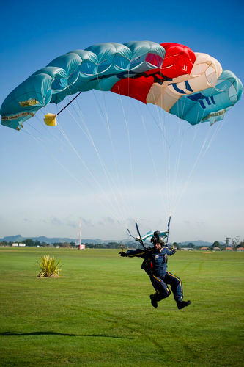
Fluid Resistance
The very large surface area of a parachute, has greater air resistance than a skydiver’s body.

Slide 14
Video

