Slide 1
Electric Current
Section 23.2

Slide 2
Electric Current
electric current
the net movement of electric charges in a single direction
when an electric current flows in the wire, electrons continue their random movement and drift in the direction that the current flows
electric current is measured in amperes (A)

Slide 3
Electric Current
Direct Current – when current flows in just one direction.
Current flowing through a battery-powered flashlight.
Alternating Current – when current keeps reversing direction.
Current running through your home.

Slide 4
Voltage Difference
Voltage – the difference in electric potential energy
when a current flows, the net movement of electric charges is caused by an electric force acting on the charges
electric charge flows from higher voltage to lower voltage
voltage difference
related to the force that causes electric charges to flow; measured in volts
a battery can provide the voltage difference that is needed to keep current flowing in a circuitts (V)

Slide 5
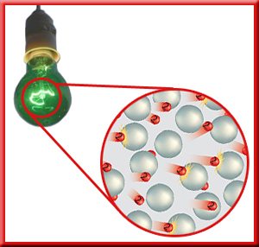
Resistance
as the electrons flow through the filament in a lightbulb, they bump into the metal atoms that make up the filament
in these collisions, some of the electrical energy of the electrons is converted into thermal energy
eventually, the metal filament becomes hot enough to glow, producing radiant energy that can light up a dark room

Slide 6
Resisting the Flow of Current
resistance
the tendency for a material to oppose the flow of electrons, changing electrical energy into thermal energy and light
resistance is measured in ohms (Ω)
Ohm’s Law
the current in a circuit equals the voltage difference divided by the resistance
V = IR
V = voltage (volts)
I = current (amperes)
R = resistance (ohms)

Slide 7
Conductors
conductor
material in which electrons are able to move easily
Have low resistance to electric current
metals are the best electrical conductors
atoms in metals have electrons that are able to move easily through the material
copper (Cu), silver (Ag), and gold (Au)
common nonmetal conductors
graphite
salt solutions (electrolytes)

Slide 8
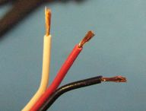
Insulators
insulator
material in which electrons are not able to move easily
electrons are held tightly
Have a high resistance to electric current
examples
plastics
glass
wood
rubber

Slide 9
Properties That Affect Resistance
Three properties determine how resistant it is to electric current.
Length – the longer the wire the more resistance.
Width – the wider the wire the less resistance.
Temperature – the cooler the wire the less resistance.

Slide 10
Video

