Slide 1
Modern Atomic Theory
PPT 3

Slide 2
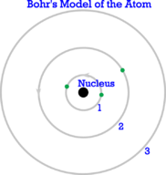
Introduction
Rutherford’s model of the atom was better than earlier models.
Bohr came up with a more accurate and useful model.
https://www.youtube.com/watch?v=thnDxFdkzZs

Slide 3
Bohr Model -Atomic Structure
Electrons are contained in shells or energy levels that surround the nucleus
Energy levels – areas located at fixed distances from the nucleus of the atom.
Each electron shell can hold a certain number of electrons
Electron shells are filled from the inside out

Slide 4
Energy Levels
There are six energy levels.
They are the only places electrons can be found.
An electron can occupy one energy level at a time and not the space in between.
The level with the least energy is the one closest to the nucleus (center).

Slide 5
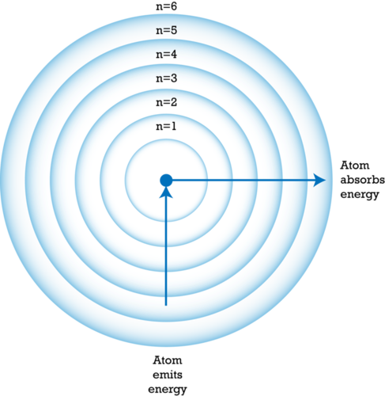
Energy Levels

Slide 6
Electron Cloud and Orbitals
Electrons do not travel in fixed paths.
They only have a certain chance of being in any particular place.
Electrons have wave-like properties.

Slide 7
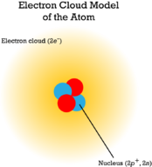
Electron Cloud Model
Electron cloud – an area around the nucleus where electrons are likely to be.

Slide 8
Orbitals
Orbitals – regions of the electron cloud that are denser where electrons are most likely to be.
Each orbital has a maximum of just two electrons.
Different energy levels have different numbers of orbitals.
Therefore different energy levels have different maximum numbers of electrons.

Slide 9
Valence Electrons
Electrons in the outer most electron shell are called valence electrons
The shell containing electrons that is furthest from the nucleus is called the valence shell
Atoms will try to gain or lose electrons in order to have a full valence shell

Slide 10
Valence Electrons
Each electron shell can hold a certain number of electrons
Electron shells are filled from the inside out
Noble Gases have full outer electron shells
All other elements have partially filled outer electron shells
Electron Shell | Number of Electrons
1 | 2
2 | 8
3 | 8
4 | 18
5 | 18
6 | 32
7 | 32

Slide 11
Lewis Dot Diagrams
Use the element symbol and the number of valence electrons
https://www.youtube.com/watch?v=ulyopnxjAZ8

Slide 12
Bohr Model Examples
For an atom of carbon, draw the model, write the number of protons, number of neutrons, number of electrons, number of valence electrons.
Carbon
Chlorine

